Slide 1

Artificial Intelligence
Dr. Piyush Joshi

Slide 2
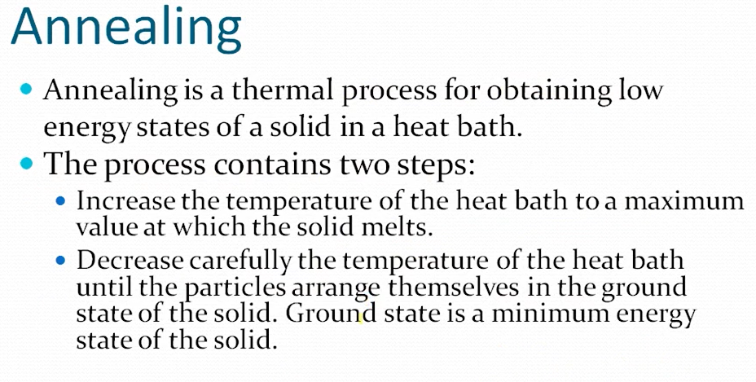
Annealing is a heat treatment process that changes the physical and sometimes also the chemical properties of a material to increase ductility and reduce the hardness to make it more workable.

Slide 3
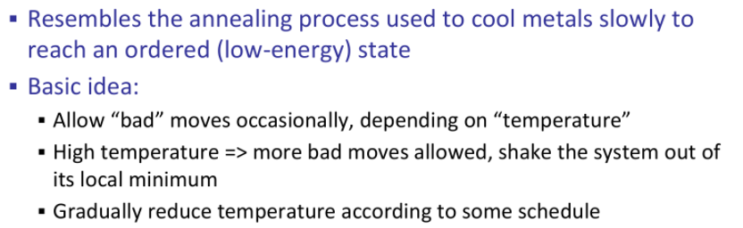
Simulated Annealing

Slide 4
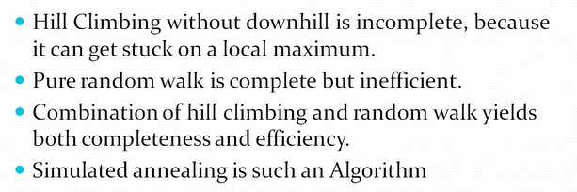
Simulated Annealing

Slide 5
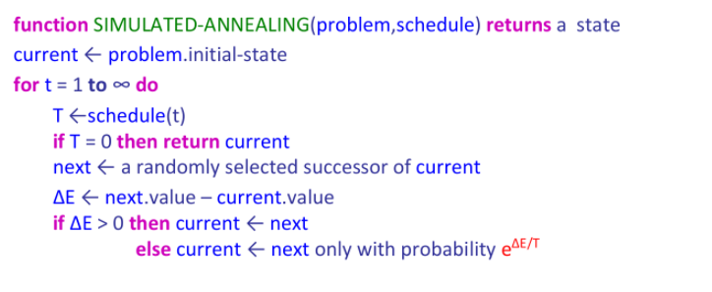

Slide 6
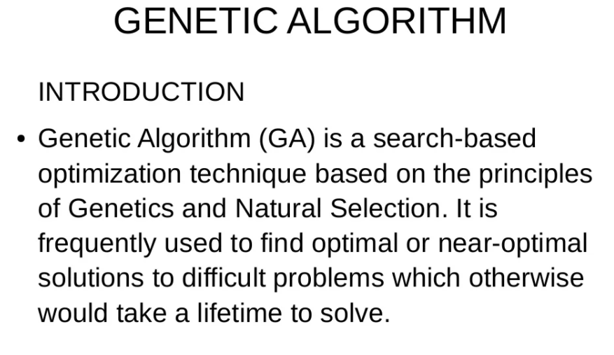

Slide 7
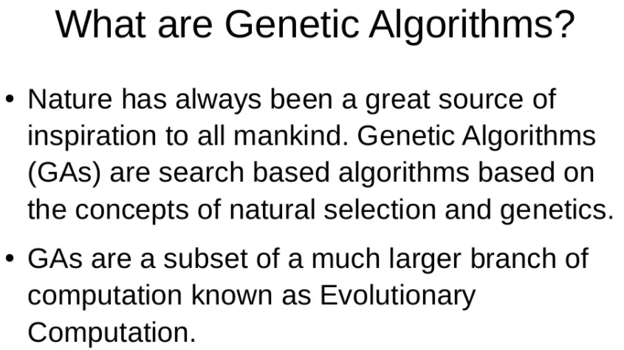

Slide 8
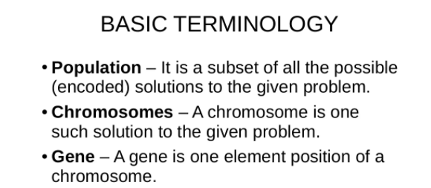
GA

Slide 9
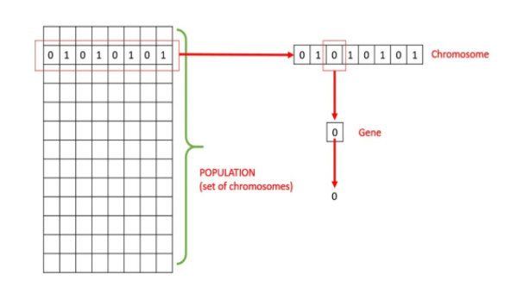
GA

Slide 10
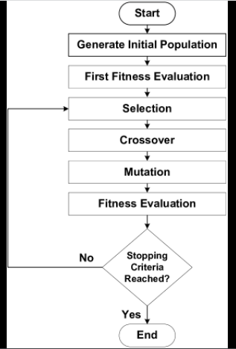
GA

Slide 11
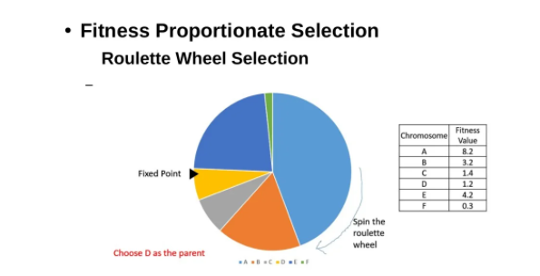
GA

Slide 12
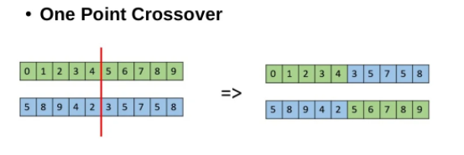
Crossover

Slide 13
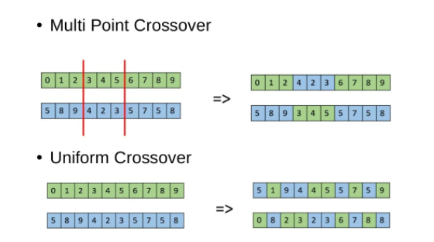
Crossover

Slide 14
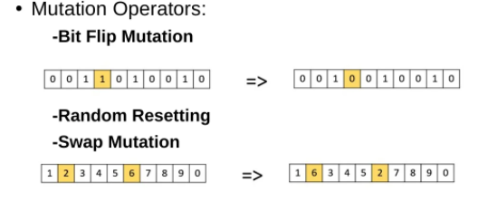
Mutation

Slide 15
